Slide 1
Collaboration is Key
Achieving Positive Outcomes for families
www.parentsplus.ie

Slide 2
Parents Plus Charity Mission
“To improve outcomes for families through training and supporting professionals to deliver evidence-based parenting and mental health programmes”

Slide 3
Parents Plus – Values and Strengths
Develop programmes to meet social challenges
Partnership with parents, children and families in development
Collaboration with professionals, agencies and community
Evidence based – integrating practice and research
Comprehensive post training support to agencies to ensure good outcomes

Slide 4
Our Programmes
Evidence-based, positive and practical interventions for families

Slide 5
Parents Plus – Evidence Base
25+ research studies, including 7 RCTs & 4 studies independent from developers, all show evidence for effectiveness of Parents Plus Programmes.
Studies consistently show that the Parents Plus Programmes are effective in:
Reducing emotional/ behaviour problems in children and teenagers
Reducing parental stress
Improving family communication and well-being
Achieving high parent satisfaction in a variety of contexts and with a large range of presenting problems and issues.

Slide 6
Parents Plus – Evidence Base
Original Programme (Behan et al. 2001; Quinn et al., 2006; 2007)
Adolescent Programme (Beattie et al., 2007; Nitsch et al., 2011)
Early Years Programme (Behan et al., 2005; Griffin et al., 2006; Hayes et al., 2013)
Children’s Programme (Coughlin et al., 2007; Hand et al., 2012; Hand et al., 2013)
ADHD programme ( Turan et al., 2021)
Parenting When Separated (Keating et al., 2013)
Working Things Out (Brosnan, 2015; Fitzpatrick et al. 2015)
PPAP & WTO (Rickard et al., 2015; Wynne et al., 2015)
Special Needs Programme (Mc Mahon et al, 2023)
Healthy Families programme ( McDaby, 2020)
Prof Alan Carr UCD conducted a meta-study of 17 of the studies published in 2016

Slide 7
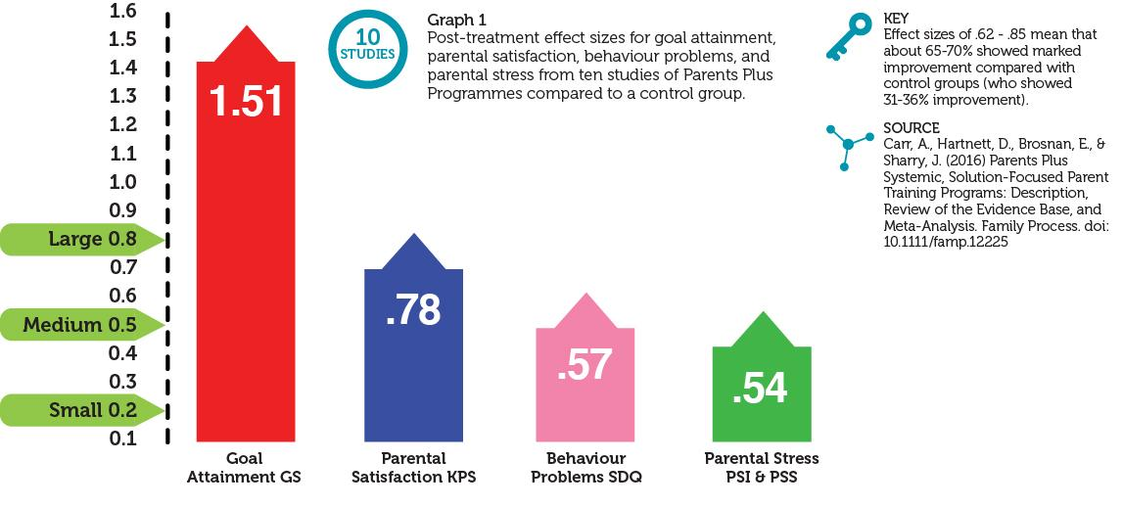
Parents Plus Programmes – Research Evidence

Slide 8
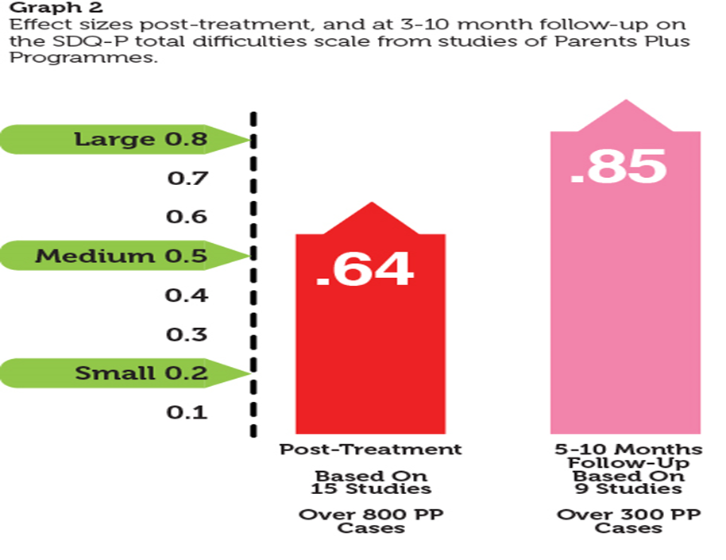
Parents Plus Programmes – Research Evidence

Slide 9
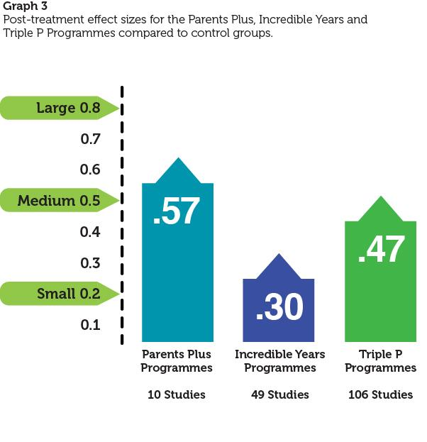
Parents Plus Programmes – Research Evidence

Slide 10
Adolescents Programme

Slide 11
Parents Plus Adolescents Programme
Parents Plus Adolescents Programme
Promoting effective communication and positive relationships with adolescents aged 11 to 16 years.
Core Inputs
1. Relationship Building with teenagers
2. Conflict resolution / Behaviour management
3. Problem Solving for families
Extra topics can be added on:
Depression / Anxiety
Education, homework & learning
Specific issues such as technology, bullying etc.
Promoting effective communication and positive relationships with adolescents aged 11 to 16 years.
Core Inputs
Relationship Building with teenagers
Conflict resolution / Behaviour management
Problem Solving for families
Extra topics can be added on:
Depression / Anxiety
Education, homework & learning
Specific issues such as technology, bullying etc.

Slide 12
Parents Plus Adolescents Programme
PPAP Session by Session
Individual Session 1: Screening
Group 1: Introduction to course & Positive communication
Group 2: Getting to know your teenager & Establishing rules
Group 3: Connecting with your teenager & Communicating rules positively
Individual Session 2
Group 4: Encouraging your teenager & Using consequences
Group 5: Listening to your teenager & Having a discipline plan
Group 6: Empowering teenager & Dealing with conflict and aggression
Individual Session 3
Group 7: Problem Solving & Dealing with specific issues
Group 8: Dealing with specific issues & Course evaluation
Individual Session 4: Follow Up
Promoting effective communication and positive relationships with adolescents aged 11 to 16 years.
Core Inputs
Relationship Building with teenagers
Conflict resolution / Behaviour management
Problem Solving for families
Extra topics can be added on:
Depression / Anxiety
Education, homework & learning
Specific issues such as technology, bullying etc.

Slide 13
Thank you for listening! www.parentsplus.ie

Slide 14
Parents Plus Adolescents Programme
PPAP Clinical Setting (CAMHS) Research
Individual Multi-site controlled clinical study
Compared to Treatment as Usual (n = 38) PP group (n = 17) showed significant reductions in: *Total Difficulties measured by Strengths and Difficulties Questionnaire SDQ *Conduct Difficulties as measured by SDQ *Peer Difficulties as measured by SDQ (PSS)
PP group showed greater parental goal attainment and reported greater improvement in their relationship with their teenager
Promoting effective communication and positive relationships with adolescents aged 11 to 16 years.
Core Inputs
Relationship Building with teenagers
Conflict resolution / Behaviour management
Problem Solving for families
Extra topics can be added on:
Depression / Anxiety
Education, homework & learning
Specific issues such as technology, bullying etc.

Slide 15
Parents Plus Mission
“To improve outcomes for families through training and supporting professionals to deliver evidence-based parenting and mental health programmes”
We are a community of professionals who want to make a difference with the families we work with.

Slide 16
Programme Delivery
Delivered over 6-12 weeks to parents or young people, individually or in small groups.
Collaborative, solution-focused and strengths-based.
Facilitated group delivery - group discussion, worksheets, exercises, video input, role-play, handouts and homework.
Comprehensive professional training, facilitator manuals, parent books, DVDs.
Post-training support, supervision and accreditation for facilitators.
Can be adapted with the inclusion of extra modules (e.g. mental health, addiction) and therapeutic inputs ( family therapy, individual support etc.)

