Slide 1
Unlocking the Secrets of Successful Programme Implementation: The North Somerset Experience with setting up and running the Parents Plus Adolescent Programme
Emma Pattinson North Somerset Family Wellbeing Parenting Lead
Notes:
Brief Intro- then next slide

Slide 2
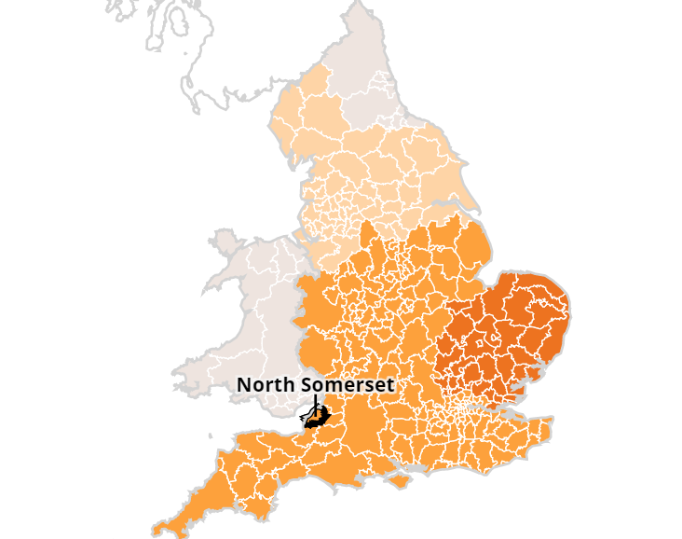
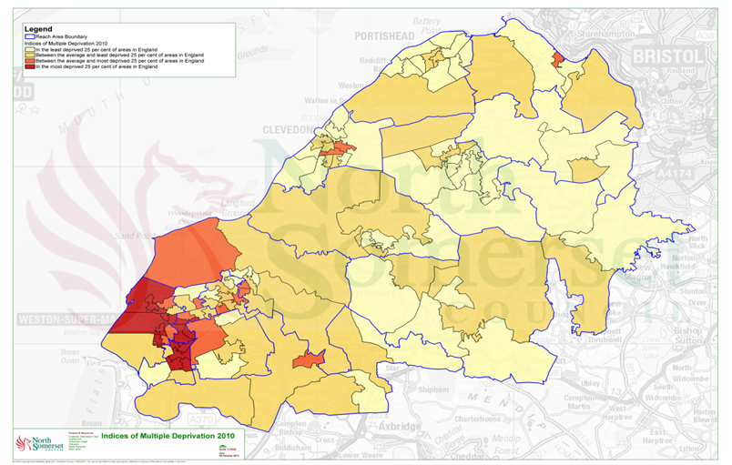
Open, Fairer, Greener
North Somerset has a population of around 220,000 people.
We are a relatively small authority with a mixture of rural, seaside and densely populated areas, this includes areas that fall in the top 25% of most deprived areas of England
;

Slide 3
Our Journey With Parents Plus
Notes:
Take you back to 2020 we had just entered the pandemic and a service transformation
Development of family hubs
Parenting lead and for Parenting to sit in Early help & children’s Centres

Slide 4
Why add to our Parenting Portfolio?
Going from 0-5yrs to 0-19yrs (25yrs send)
Looked at the Bristol model
PP running successfully in Bristol
Cost saving re number of weeks roughly 40% cheaper than other programmes
Attractive resource wise as once accredited only 1 group lead needed and accreditation process thorough but not as time intensive as other programmes
Flexible programmes e.g. WTO can be used creatively- sections at back of each manual with extra resources
Cost efficient in terms of training and resources
Access to everything online; videos, posters, leaflets, extra resources.

Slide 5
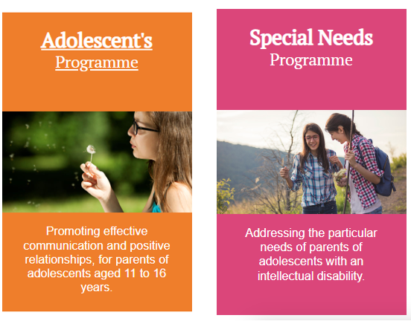
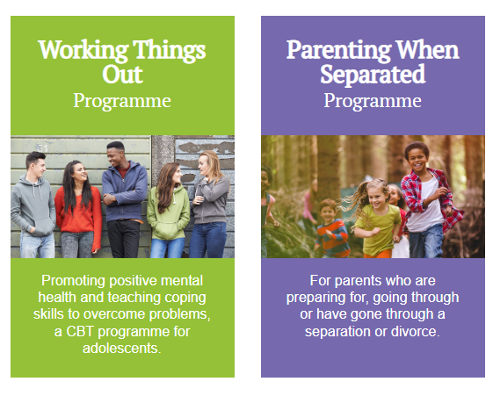
TIMELINE
January 2021 | January 2021 | July 2021 | October 2022
Notes:
In January 21 we trained in and started delivering straight away PPAP
online because of lockdown
Very easy to set up and first cohort of parents recruited from existing NVR referrals- at the time our only adolescent option.

Slide 6
Setting up
PP very easy to deal with
Fast delivery of manuals
Training flexible
Training Online
Supervision offer
Notes:
It was so easy to get started
You are talking to one person who co-ordinates everything for you including linking you with a trainer, billing and delivery of manuals etc
Manuals arrived promptly and contain everything you need to get started including posters
The offer of training was good, we could either join in with the online training already on offer or if we could provide enough practitioners have our own training
On top of that each facilitator can access 2 free supervision sessions
In fact so easy to run we delivered three groups the first year and now deliver between 5-6 groups per year

Slide 7
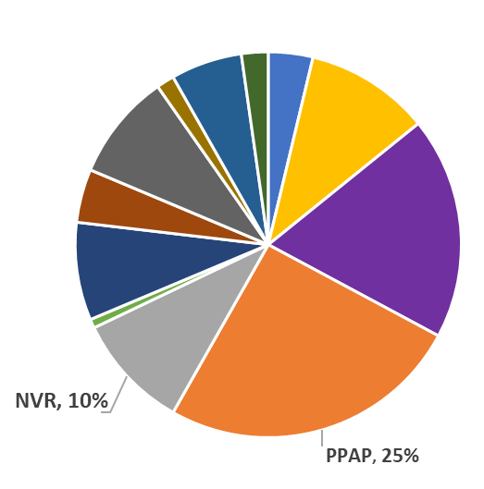
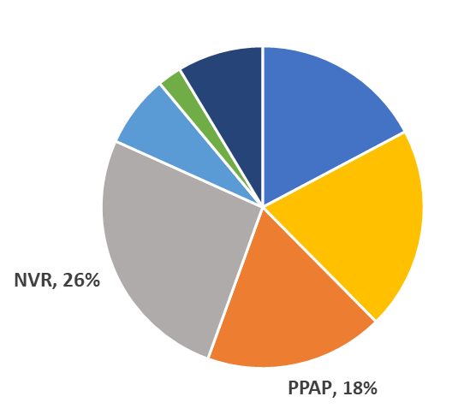
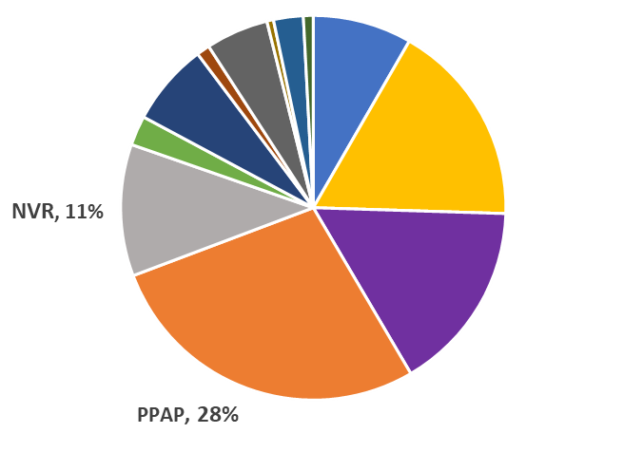
The Parents Plus Adolescent's Programme has quickly become our largest referred to programme .....
2021
2022
2023 so far!
*% depicts % of all referrals received that year
Notes:
Non-Violent Resistance (work with parents of children 9-17) was the biggest referred to programme in with 26% of all referrals received in 2021.
In 2022 PPAP took over with over 28% of all referrals received, and has since been our largest referred to programme.
If we look at the two programmes, on average we receive 150% more referrals for PPAP compared to referrals received for NVR per year.

Slide 8
Parents Plus Adolescent’s Programme – Average Routine Outcome Measures
Notes:
Although SDQ results show very little in terms of impact on child,The reasons lie in the fact this is a 6 week programme and seeing huge changes is unlikely, these will take time to improve and we would expect to see a downward trend in time and with consistency.
I will be interested to see what this looks like when we finish our first joint PPAP and WTO ? I am predicting there will be a more visible reduction in SDQ scores.
Excitingly the distance travelled in terms of parental goals is good and consistent with parent feedback about the difference the course has made to life at home.

Slide 9
Parents Plus Adolescents Programme: Parent’s feedback
I think I've started to better understand how my child approaches their challenges and what she finds difficult. So I am starting to be able to plan ahead when I can see trouble coming her way to help her find solutions. We're feeling more like a family
My child is now getting to school and has managed to go to all of his mock exams. He has also joined in with football over the half term!
The course helped me to understand how to talk about issues with my child
My child has gone 40 days without self-harming
The most helpful part of the course was learning coping strategies - especially the
Pause button!

Slide 10
An issue we had not just for this group, but all groups was the number of parents declining the groups offered, reasons given were around the following:
Lack of childcare where creches were not on offer for younger children
Children in bed.
Money for transport unavailable due to the cost-of-living crisis
Distance to travel too great
Anxiety around leaving the house/attending a group/ poor mental health.
Work/ timing issues etc.
Parents wanting to attend with partners but working away.
For parents living in the North of North somerset it can take up to an hour on public transport to get across the area. - 57% of all referrals over past 12 months were based in South / East (Weston-s-Mare), 43% were North based.
Funding for taxis to get families to parenting groups withdrawn in 2018 due to austerity measures

Slide 11
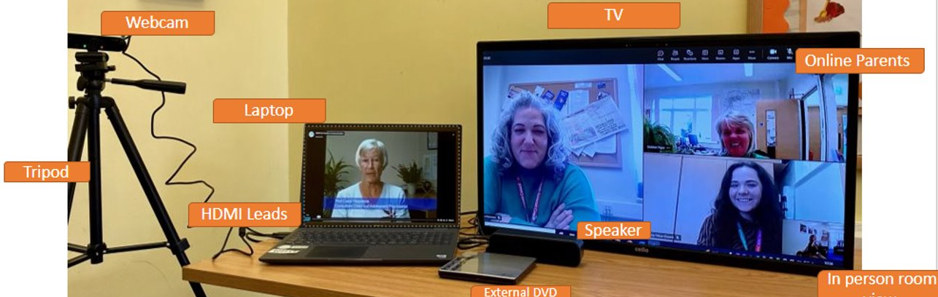
What we did...
Introduced a Hybrid model - groups run in the evening
Room set up takes around 35 minutes​
Tech check; including webcam position.​
Projector on wall to ensure online parents are clearly visible /or TV ​
Join meeting early to ensure link is working​
Open videos on desktop and any other resources we are going to share​
Have flip chart ready, agenda and ground rules displayed as usual. ​
Microphone and camera on and parents welcomed in the room and online as they arrive.​
Offer a week zero or practice sessions for parents who are less confident and make sure joining instructions are contained within the email invite.
Notes:
We already knew we could deliver online groups but parents wanted both an option to join virtually or in person
last group we ran 5F2F parents 9 online
82% retention rate- that's higher than our average of 70%
Found both sets parents more likely to join if online
Feedback we had-

Slide 12
Feedback ...
Hybrid PPAP - September 2022
This has been a very good course; insightful and well lead. Also, the booklet has been useful. This course has given me a different perspective, that we are not alone in our challenges, talking helps, try different approaches. Press your pause button and listen!
If I didn’t have the option to join online, I would not have been able to do the course as I work away, so thank you. Keep offering this service it is really important and needed.
Notes:
Dad is in the Army and works away Monday – Friday

Slide 13
Linking up with colleagues in Bristol
Peer supervision
Joining up to facilitate online programmes- pooling of expertise and resource

Slide 15
Commonly Asked Questions About Hybrid Groups ...
Sound External speaker, You will need a microphone either integrated into the speaker/webcam or standalone to ensure the quieter parents can be heard.
How do we manage the group?
Time given equally between the room and online, quieter parents invite to contribute by group leader as modelled in PPAP training.
Parents encouraged to keep cameras on, we add it to the ground rules.
Project the online parents onto screen, or up on the TV - it’s important that we still see the parents when showing the DVDs or during group discussions in order to gauge responses
Face to Face parents are responsible for online parents – we add it to the ground rules!
Camera swivels round to cover flip chart when we are writing up any discussions up etc.
All parents have the Group Leaders mobile / email contact details.

Slide 16
Commonly Asked Questions ...
Breakout rooms/ role play & discussions
Breakout rooms can be used for role play and discussions, group then comes back together and invited to share thoughts.
Breaks
One of the group leaders will monitor the online families to see if anyone requires support in break. Quite often parents make a drink/go check on children/ chat to the other online families.
Invitations
Email sent via Outlook which includes the MS Teams meeting details (same invitation used for duration of course and set up as recurring. Be sure to BCC all families.
Playing DVDs
We use the online videos via the Parents Plus website, or an external disc drive to play DVD disc via a laptop, and then use the “Share Screen” function in MS Teams so families at home can see and hear, and the F2F families can view via the TV / Projector.

Slide 17
Commonly Asked Questions...
Parents that speak quietly
The Group leader uses summarising and paraphrasing constantly so that parents hear and get same messages. Microphones will help​
Loss of connection
(Added to ground rules) Families reassured we will re-join as soon as possible. I usually have an alternative ready such as joining on a mobile phone.
Feedback / Weekly evaluation​ forms
Paperwork has already been delivered to families prior to course. We then ask them to complete the evaluation forms before they log off the session, Photograph on their phone and email through to the group leader.
Any work produced on flipcharts is photographed and emailed to all parents at end of session .
Weekly phone calls/ email access
Parents given a weekly call or email access to the group leads as an opportunity to talk 1-1 outside the group- this supports retention rates.

Slide 18
Considerations:
Data poverty: It really is worth looking into what's available in your local area
Libraries run schemes where you can get data sim cards
Schemes are available where you can get vouchers for free broadband
Grants can be applied for laptops
Parents can access on mobile phones,
using headphones is encouraged

