Slide 1
Moving Online… Prof. John Sharry Social Worker and Founder Parents Plus Charity www.parentsplus.ie

Slide 2
Our Mission
“To improve outcomes for families through training and supporting professionals to deliver evidence-based parenting and mental health programmes”
We are a community of professionals who want to make a difference with the families we work with.

Slide 3
Our Programmes

Slide 4
Our Research
Strong Evidence Base:
24+ research studies, including 7 RCTs & 4 independent studies show that the Parents Plus Programmes are effective in:
Reducing emotional/ behaviour problems in children and teenagers
Reducing parental stress
Improving family communication and well-being
Achieving high parent satisfaction in a variety of contexts and with a large range of presenting problems and issues.
Source: Carr, A., Hartnett, D., Brosnan, E., & Sharry, J. (2016). Parents Plus systemic, solution-focused parent training programmes: Description, review of the evidence-base, and meta-analysis. Family Process. doi: 10.1111/famp.12225

Slide 5
Delivering our Programmes
Over 6 to 12 weeks to parents or young people, individually or in small groups
Solution-focused and strengths based
Drawing on social learning, communication and attachment ideas
Can be used universally, preventatively and as interventions across sectors
Includes practical teaching strategies such as video input, role-play, group discussion, worksheets, exercises, handouts and homework

Slide 6
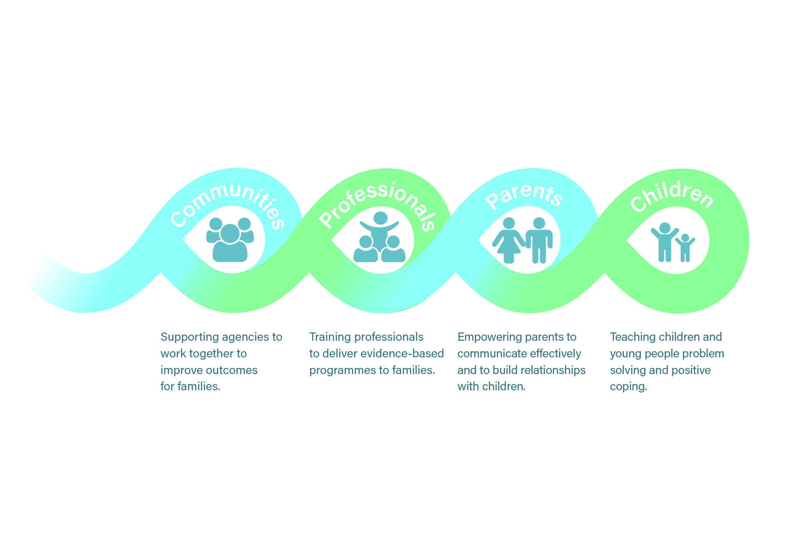
Parents Plus Programmes
Empowering Communities, Professionals, Parents and Children

Slide 7
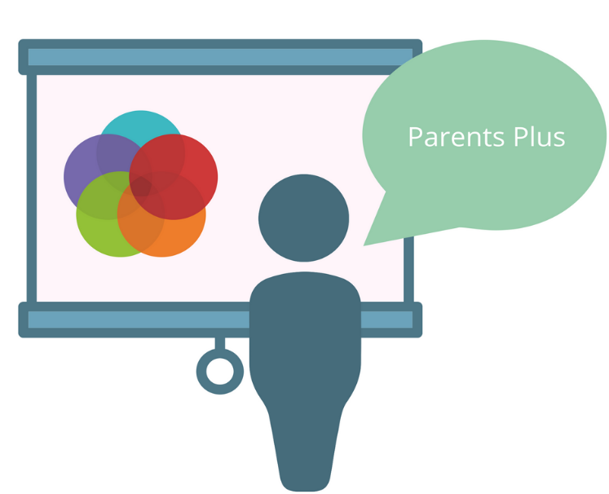
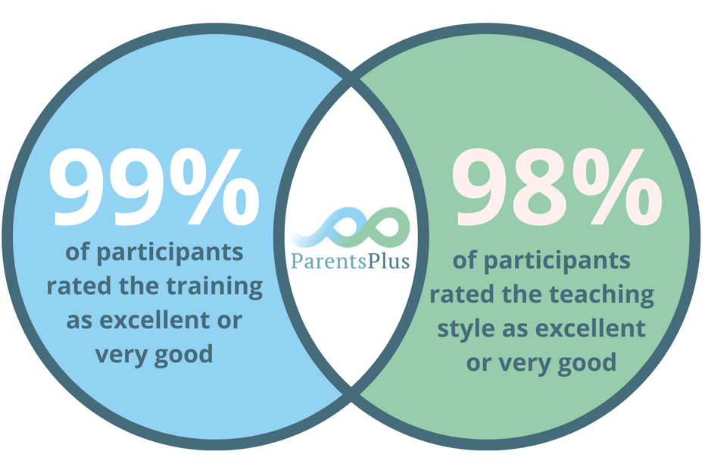
Our Training
‘Train the trainer’ model ensures a long-term, sustainable benefit for facilitators, communities and organisations.
Accreditation process and post training support ensures effective delivery and helps to develop professional practice.

Slide 8
Covid-19 Strikes…

Slide 9
Moving to remote working
Our team now works remotely online to
Support facilitators delivering groups and sessions online and by phone
Provide Parents Plus programme facilitator training online

Slide 10
Which Software Platform?
We support professionals using all platform types (e.g. Zoom, MS teams, Google, phone conferencing, whatsap, face time etc..)
Depend on agency policies

Slide 11
Advantages of online/ phone
Geographical Access
New communication possibilities e.g. via chat

Slide 12
Challenges
Technical Set up
Helping parents creating space at home
Have to work harder to engage participants

Slide 13
Making online work therapeutic?
Prepare with individual calls
Gallery view to see all on screen at once
Use Gesture and Body language
Break out rooms for small group work
Chat function for increased interaction
Role plays and demos can work well
Still offer Tea/ coffee and Pizza……!

Slide 14
What we have learnt?
Much more successful than expected
Can preserve therapeutic benefits, but have to work harder to engage participants
Preparation is key both for parents and professionals

Slide 15
More information 15th June - Training in Online working 22nd June Parents Plus Children’s Programme Facilitator Training www.parentsplus.ie

