Slide 1
“ An Autistic ADHDer”
“ A parent to 3 neurodivergent children”
“A Parents Plus Facilitator within CAMHS”
“An educator, trainer and advocate for ADHD and Autism”

Slide 2
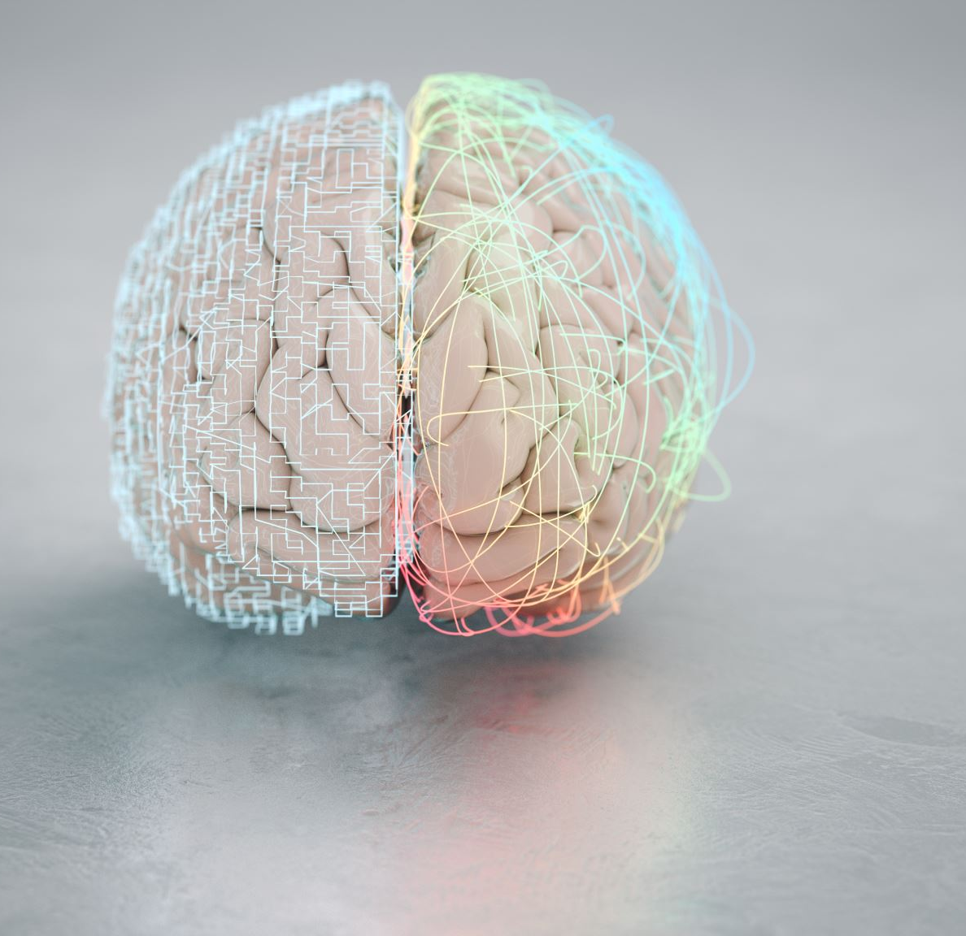
Neurodiversity ‘A natural variation across human brains’
A brain that ‘diverges’ significantly away from the majority brain are termed neurodivergent (ND) . This includes the ADHD brain.
Society , rules and expectations are largely set up for the majority , neurotypical (NT ), brain.
Neurodivergent brains are not a ‘broken ‘ or deficient version of a neurotypical one.
All brain types are valuable.

Slide 3
Neuroaffirming parenting seeks to :
Understand and accept difference to enable your child to be their true authentic self.
Provide autonomy (let your child make their own choices)
Take a strengths-based approach and embrace interests.
Provide support and adjustments to the environment that affirms their brain type.
Be trauma-informed
Learn from adult ND voices
Nurture development of a positive ADHD identity

