Slide 1


A Rising Tide:
The potential & possibilities of
community-based Parenting Supports
Adrienne Streek – FPI Coordinator
Sarah-Jane Gerber – FPI Lead Researcher

Slide 2
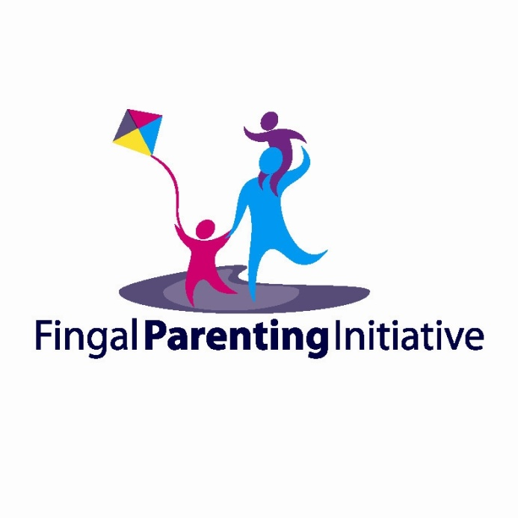
Fingal Parenting Initiative
The Fingal Parenting Initiative was developed in 2010 by the Fingal Children’s Services Committee in order to address local demand for parenting support.
The Fingal Parenting Initiative is a collaboration within and across a range of local level organisations. These include; pre-school services, public health nurses, social work teams, family resource centres and community development projects in Fingal.
The overall aim of the Fingal Parenting Initiative is to strengthen the capacity of childcare providers, increase parental wellbeing and enhance family support services in order to improve outcomes for children and families in Fingal.

Slide 3


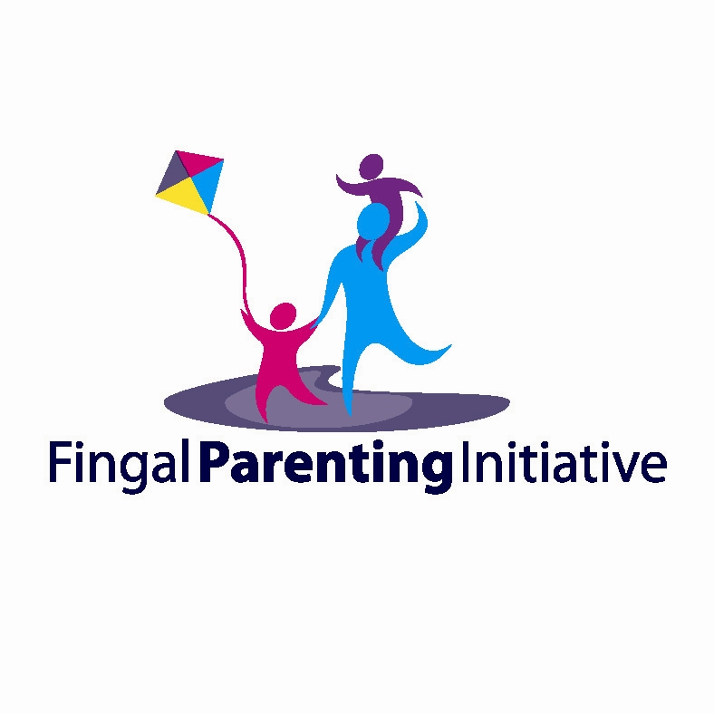


Fingal County Childcare Committee
Blanchardstown Area Partnership
Barnardos
Child & Family Agency

Slide 4
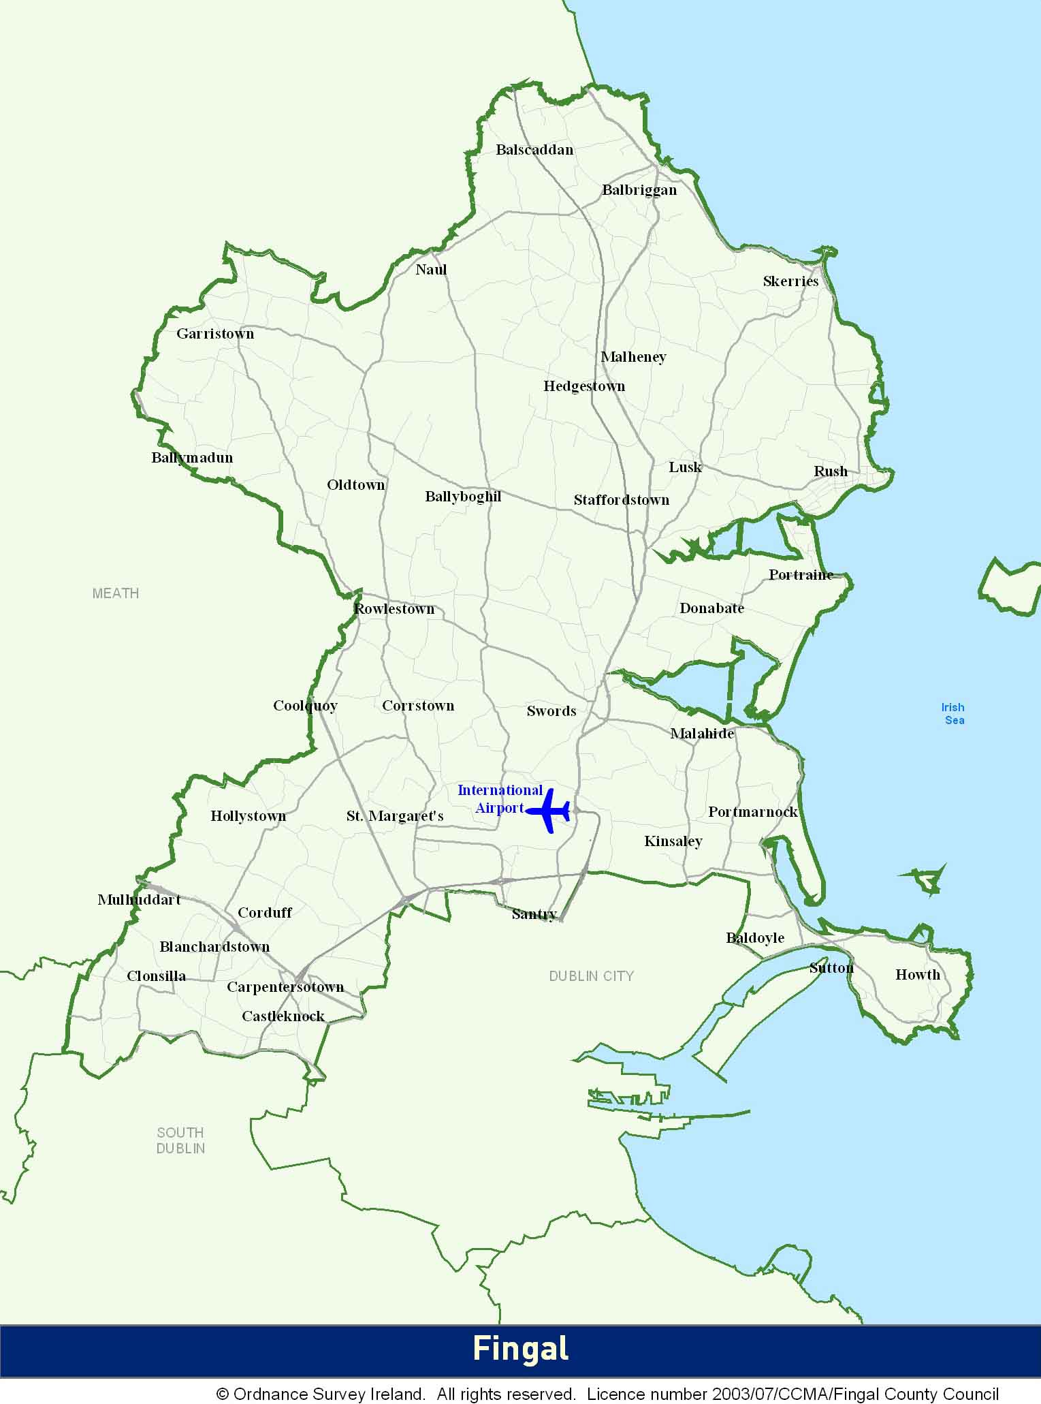
County Landscape
Fingal County covers an area of 450 square kilometres (173 square miles)
The population of Fingal as per the 2011 Census is 273,991 (over 6% of the national population)
33 of the 42 Electoral Districts are inclined toward affluence with strong indicators of deprivation and disadvantage in Dublin 15 and Balbriggan-Urban.
Fingal is the ‘youngest’ county in Ireland

Slide 5
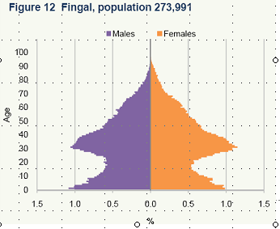

Slide 6
Fingal Parenting Initiative
Universal access to a suite of supports including:
Parent Workshops
Online support and information
Social networking
Local links and contacts (networks and multiagency collaboration)
Parent Support Programmes (7 weeks)

Slide 7
Key Deliverables
4 established link sites/hubs
5000 + website visits since 2011
10 parent workshops (400 + parents)
80 trained facilitators delivering courses
Accreditation of local facilitators
35 sites for delivery of parenting programmes
80 parenting programmes (7 week) delivered to over 800 families
Direct engagement with over 1200 families in Fingal
and still going……

Slide 8
Evidence Base
Strong evidence for effectiveness of parenting programmes
Growing evidence base that attests to the efficacy of Parents Plus Programmes
Recent study in community setting
(Kilroy, Sharry, Flood & Guerin, 2010)
Can Parents Plus replicate these findings in community settings with delivery by early years educators and community support services?

Slide 9
Methodology
Measures that are universal, standardised and widely used:
Strengths and Difficulties Questionnaire– measures parent perceived strengths and difficulties for the child
Parent Stress Scale – measures parental stress
Kansas Parenting Satisfaction Scale – measures parents satisfaction with their parenting skills

Slide 10
Results
N = 286 programme completers (continued evaluation)
Guardians: 85% mothers, age range 19 – 70 years (average age 35.44)
Children: 62% boys, age range 6 months – 7 years (average age 3.59)
Significant reductions in parental stress and child difficulties & significant increases in parenting satisfaction after the 7 week programme.
Large to medium effect sizes

Slide 11
Outcome Measures (Entire vs Clinical Sub-Sample)

Slide 12
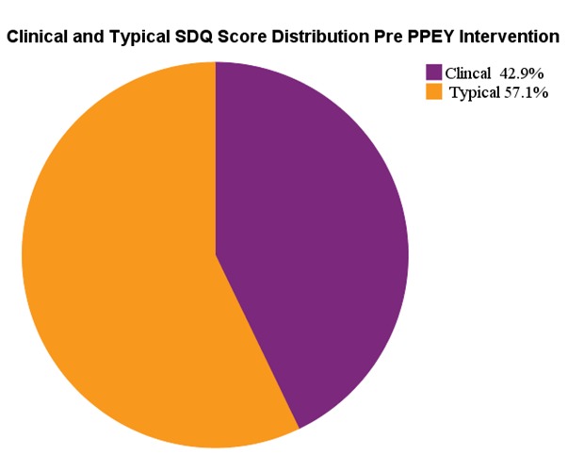
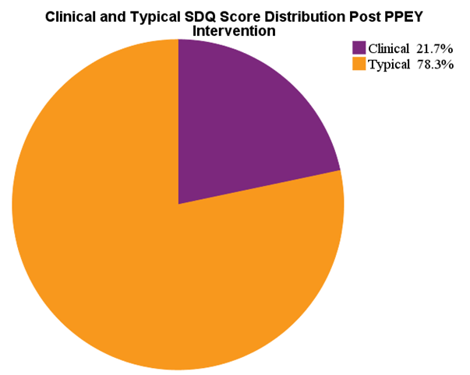
Typical and Clinical/Borderline
Pre- Intervention
Post - Intervention

Slide 13
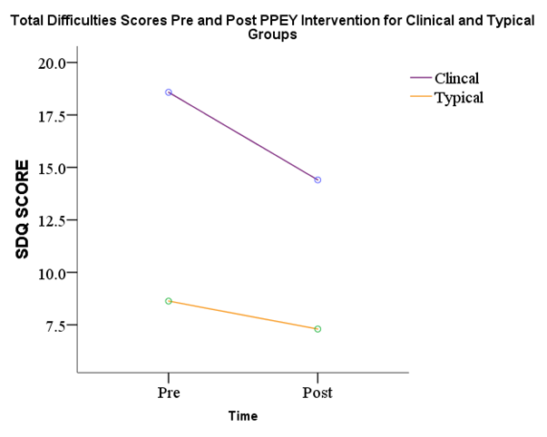
Comparable Effect Size for Clinical Group

Slide 14
Parent Reflections
‘My child stopped having tantrums, she told me today that I am a much better mummy’
‘I have learned to stop and pause and be more tuned into my son. I feel more confident as a parent. I now enjoy my time spent with my son’

Slide 15

Key Learning
PPEY effective in community settings lead by community workers
PPEY effective for both clinical/borderline and typical range participants (‘Worried Well’)
Non-stigmatized, acceptable support
Increase in parental well-being and reduction in parental stress- outcomes for children
Cost effective per child compared to contemporary programmes
Cost Effective to roll out – facilitators own time
Reduced wait list time to access support
Potential reduction in need for CAHMS services

Slide 16
Legacy?
The aim of the Fingal Parenting Initiative was to:
Strengthen the capacity of childcare providers
Increase parental wellbeing
Enhance family support services
Children and families require a meaningful commitment at national level to proven supports that enhance children’s lives through mainstreaming of programmes such as the Fingal Parenting Initiative.

